Slide 1


An Introduction
Into the Fundamentals
of the Microsoft Graph API
@PowerShellMich1
Notes:
PRE START
Hide Icons
Start Function App.
Remove all non essential programs (Spotify, Steam, Discord,)
START:
Welcome to my talk on an introduction into the fundamentals of Microsft Graph API.
So why?
While its great having all these tools available the underlying API can daunting to learn.
However I’m here to demystify that notion and provide you with the tools needed to get up and running

Slide 2





About Me
@PowerShellMich1
https://github.com/ZanattaMichael/BrisPug
https://twitch.tv/PowerShellMichael
Notes:
A little about me:
I work as a senior consultant at Insync Technology and I specialize in WinOps Automation and PowerShell SME.
REST is my bread and butter
I’m am known as that guy. I like to push the boundaries of PowerShell to the limits to see what is possible. For instance a PowerShell Aimbot, Remote HTTP PowerShell Bot and a Stock Market Forum Web Scraper.
Stream Regularly, CoFounder the Brisbane PowerShell User Group and Author (Contributor and Editor for PSConfBookV2, PSConfBookV3)
I enjoy running and playing paintball

Slide 3

TRADITIONAL OWNERS
WELCOME TO OUR SPEAKERS AND PARTICIPANTS FROM AROUND THE WORLD
We acknowledge the traditional custodians of the land on which this online conference is hosted, and the traditional custodians of the lands where our Australian-based speakers and participants are located.
We would also like to pay our respects to Elders past, present and future
Tēnā koutou, tēnā koutou, tēnā tātou katoa. On behalf of M365 May we would like to welcome and acknowledge all our speakers and participants from Aotearoa New Zealand. Thank you for supporting this hui.
Tēnā koutou, tēnā koutou, tēnā tātou katoa.
Notes:
We acknowledge the traditional custodians of the land on which this online conference is hosted, and the traditional custodians of the lands where our Australian-based speakers and participants are located.
We would also like to pay our respects to Elders past, present and future.
Tēnā koutou, tēnā koutou, tēnā tātou katoa. Ko Rebecca Jackson tōku ingoa. Nō Melbourne au. On behalf of M365 May I would like to welcome and acknowledge all our speakers and participants from Aotearoa New Zealand. Thank you for supporting this hui.

Slide 4
CODE OF CONDUCT
Be constructive, be respectful, be helpful and be kind.
THE QUICK VERSION
Our conference is dedicated to providing a harassment-free conference experience for everyone, regardless of gender, gender identity and expression, age, sexual orientation, disability, physical appearance, body size, race, ethnicity, religion (or lack thereof), or technology choices.
We do not tolerate harassment of conference participants in any form. Sexual language and imagery is not appropriate for any conference venue, including talks, workshops, parties, Twitter and other online media. Conference participants violating these rules may be sanctioned or expelled from the conference without a refund at the discretion of the conference organisers.
THE LESS QUICK VERSION
www.m365may.com/code-of-conduct

Slide 5

The Breakdown
An Introduction to HTTP, JSON, REST & OAUTH
Authenticating with Microsoft Graph
Navigating Microsoft Graph URL Endpoints
Additional Resources
Questions

Slide 6
What won’t be covered
Postman
Deep Dive into JSON Web Tokens
Microsoft Graph WebHooks
Microsoft Graph Subscriptions

Slide 7
Let’s Get Started!

Slide 8
What is HTTP?

Slide 9

HTTP – Hypertext Transfer Protocol
Request / Response Application Protocol
Client running an Application
Server running Webserver
Notes:
HTTP is a Request Response Application Protocol that is built on TCP/ UDP. TCP Ports 80,8080,3124,443
Clients communicate with the server by issuing requests and the server responding with responses.
The Client running an Application (A browser for instance) will use this to communicate with services on the internet.
Servers running a WebServer or (WebSerivce) such as (PHP, IIS, Apache, Tomcat) will service these requests.
Data is transmitted using the body

Slide 10
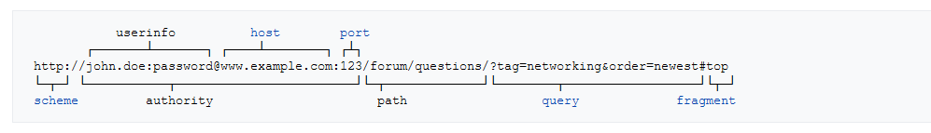
HTTP: Breakdown
HTTP Header: Describes the characteristics of the request\response
Body: The data being sent and received
Method: Describes the Action of the Request
(GET, POST, PATCH, PUT)
URI: The endpoint being accessed:
Notes:
Each request and response will the have following elements:
A HTTP Header describes the characteristics of the request (instructions on how to read a book). For instance:
Response HTTP headers contain HTTP Status Codes. HTTP status codes (404, 403, 300, 200)
Language Type: For Instance you have a client when communicating with the server the client will request specific a language type.
HTTP Headers are stored in Key: Value pairs
The HTTP body contains the data or (payload) that is being sent and received. (Using the actual book analogy) The body can be encoded with different data types such as XML, JSON, YAML even a byte array!
Then we have the method. The method is used in the client request to describe the intended action of the request. A good examples are:
GET – Retrieves a resource
POST – Pushing/ Creates a resource
PUT/PATCH – Updates a resource
DELETE – Removes a resource
The two most common are GET & POST
Finally you have the URI. Yes I said URI not URL. The URI is a schema that describes HOW the http endpoint should be accessed:
In the example below you can see the following:
The scheme dertmines the type of request:
HTTP
HTTPS
FTP
SFTP
The Authority which contains:
User Info: Use login information. Note it’s denoted by <username>:<password>
Host: The hostname of the endpoint.
Port: A custom port. By default a browser will assume the port will be (443, 80, 8080, 8081, 3124, 20 - FTP)
The Path:
The URL Path describes location of the service. Think of it as a file path. Different paths provide different servies.
The Query (Note that it’s prefixed with a “?”:
Queries enable server-side filtering and selection improving performance. It’s denoted by Name=Value separated by the “&”
The Fragment is used to refer to a resourse that is subordinate to another, primary resource.
In this instance you can see that they are wanting the top result

Slide 11
HTTP: Queries and Fragments
Query:
“?” Introduces Query
Key=Value
Multiple Key Values Separated by “&”
Fragment:
“#” Introduces Fragment
Key=Value
Multiple Key Values Separated by “&”

Slide 12
HTTP: Status Codes
200 – All good!
300 – Redirect Me!
400 – Client Issues!
401 - Forbidden
403 - Authentication
404 – Page Not Found
500 – Server Issues!

Slide 13
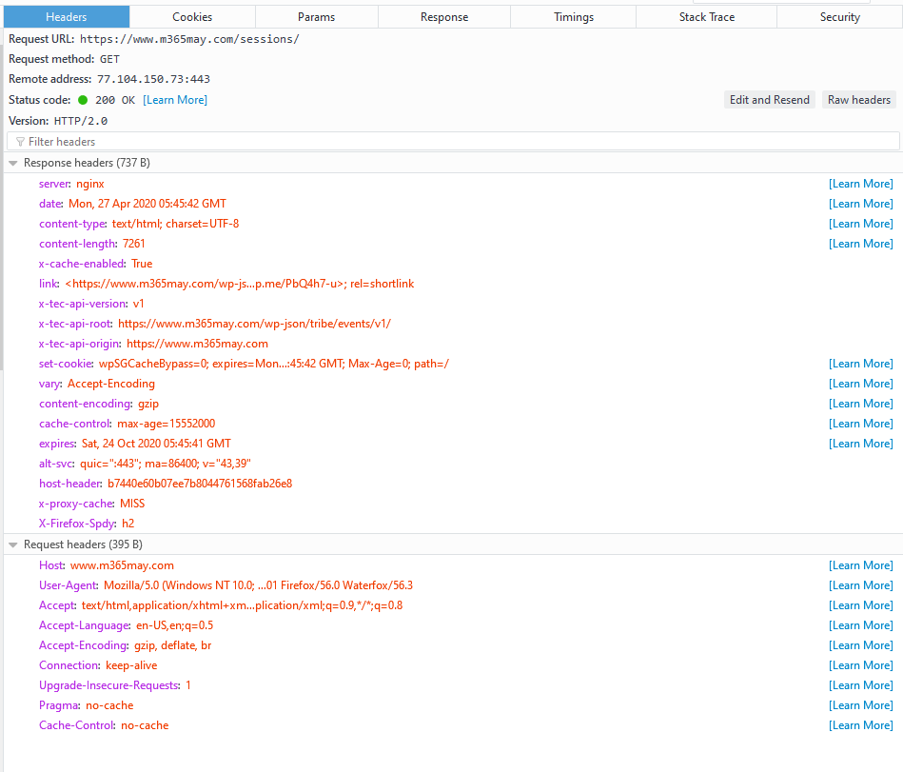
HTTP:
A Header
Notes:
Below is a simple breakdown of the HTTP Status Codes
200

Slide 14



A Simple HTTP Process
Client
Server
URI: www.google.com
HEADERS:
AGENT-TYPE: BROWSER
METHOD: GET
HEADERS:
HTTP Version
STATUS CODE: 200
BODY: <HTML></HTML>
URI: www.google.com/login
HEADERS:
AGENT-TYPE: BROWSER
METHOD: POST
BODY: { USER: “JOHN” ; PASS: “123”}
Notes:
So Let’s look at a simple HTTP process:
The Client using a browser enters in www.google.com. The browser will:
Using the URI schema determine the endpoint, port, scheme.
Construct a HTTP header, provide basic information about the browser language, encoding types.
Determine the Method. Since we are making an initial request, this will be a GET
The server received that request and do the following:
make a determination if the request is valid.
Does it require username and password?
Is the encoding type correct?
is the browser compatible?
constructor response header containing:
the body encoding type
the status code
session tokens/ cookies
the body of the request, containing HTML, Javascript & CSS.
The client will then receive that response and process is as follows:
reviewing the headers\ status code
Passing the HTML body into the browser DOM (Document Object Model). The DOM will render the HTML Body:
Loading any dependencies that are in the body (CSS Styling, Javascript)
Display the HTML Elements as they appear
Now in this instance the user wants to log into Google. so the user fills in his user information then clicks login button:
The Client will:
Using the URI schema determine the endpoint, port, scheme. In this instance the path is /login
Construct a HTTP header, provide basic information about the browser language, encoding types.
Determine the Method. The content provided by the server tells us that this request is a POST
The Username and Password are encoded and added to the HTTP Body
The Server Will:
make a determination if the request is valid.
Does it require username and password?
Is the encoding type correct?
is the browser compatible?
constructor response header containing:
the body encoding type
the status code
session tokens/ cookies
the body of the request, containing HTML

Slide 15
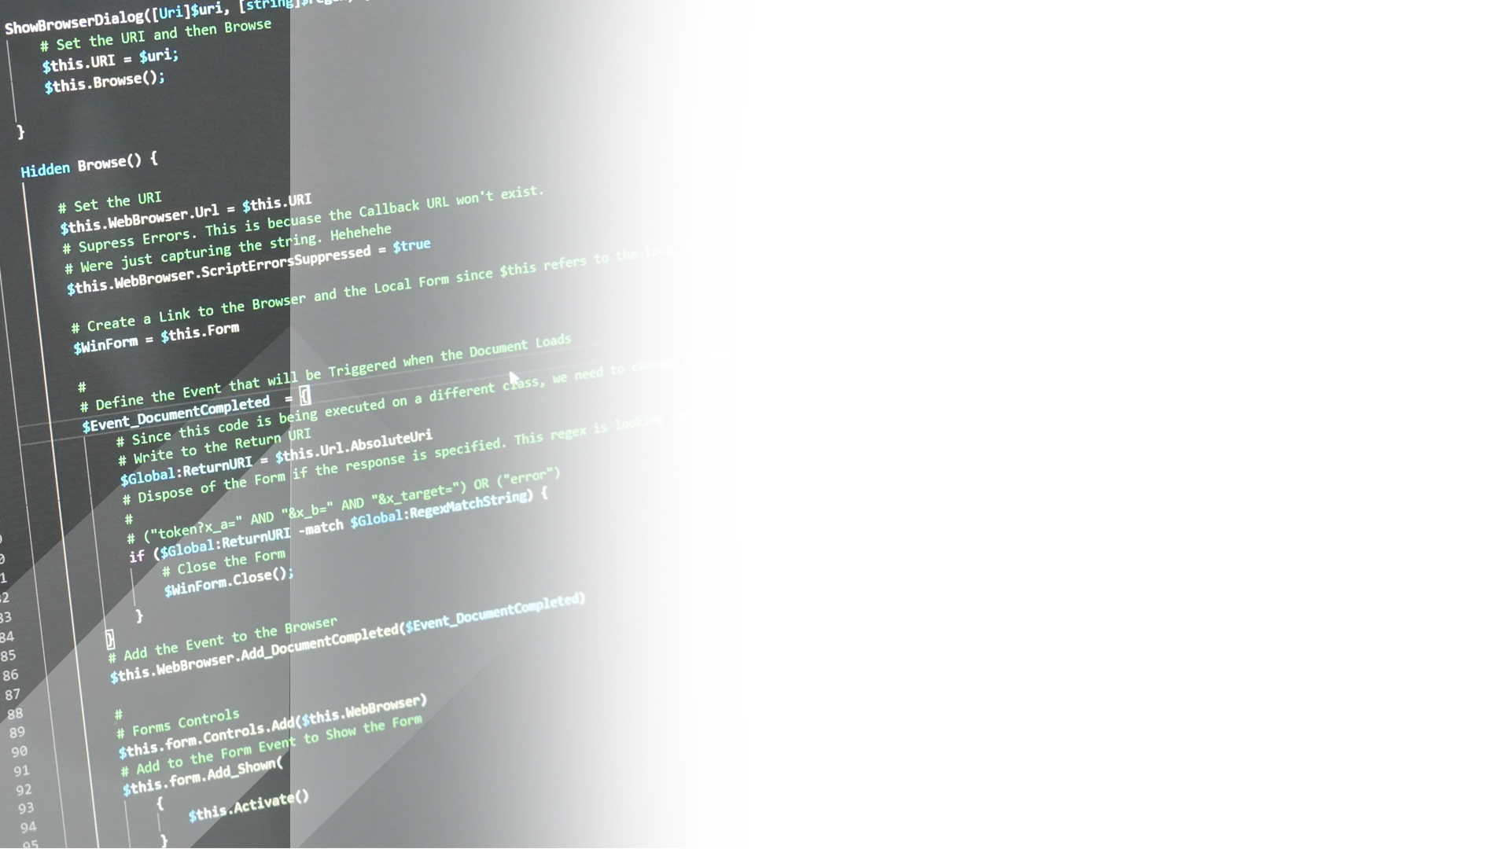
HTTP: Demo
Notes:
Use m365may.com as an example:
Open Firefox. Explain to the user that we can use a browser to show us the interactions used to load a webpage.
Open the Developer Tools. (Press F12)
Once we have done that we are going to select the network tab. This will show us the requests and responses.
Run: https://www.m365may.com/
Note the status codes to the client.
Select the Initial Request (Not the file /) that is the default path.
Note that the subsequent lookups are resources that are defined in the initial request that are needed by the DOM to render the page.
Review URL
Request the Request Method
Review the Status Code
Review Request Headers
Review Response Headers
Select Response
Minimize Preview
Review Response Payload
Note the HTML response

Slide 16
What is JSON?

Slide 17
JavaScript Object Notation
Encoding Type
Used within the HTTP Body
Allows Representation of Data in Plaintext
{} Indicates an Object
[] Indicates an Array
“Key” : “Value”
\
Notes:
JavaScript objects notation is a specific encoding type that allows applications to communicate with others
in this instance Jason allows representation of data in plain text that is human readable. REST Relies heavily on JSON.
the curly braces within Jason indicate an object within the Jason. an object is a simple grouping of data. An object could be a book.
square brackets indicate an array or grouping of objects. arrays are groups of similar items. For Instance: a group of numbers could be in an array, or how grouping of books in a series.
Data is denoted by a key representing the object property and the value representing the object value. Using the book as an example it could be: The Title, A Cover, A Story, Pictures

Slide 18
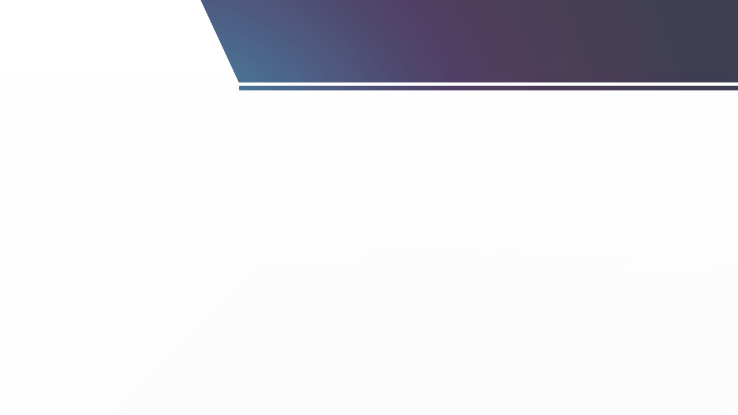
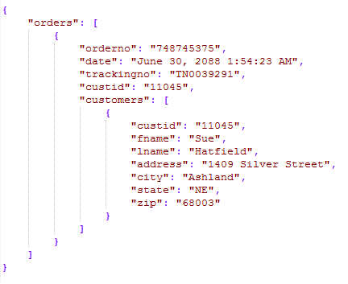
Let’s Take a Look!
Notes:
Before: Start local http function
Explain to the users to ignore the postman interface and focus on the content:
Play Demo_01.mp4
Open Postman
Open Demo 1 – JSON
Click Send
Review the Text response note to the users on the syntax:

Slide 19
What is REST?

Slide 20
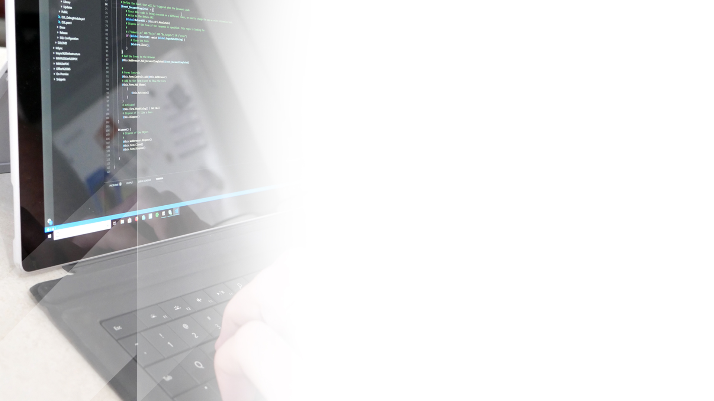
What is REST?
REpresentational State Transfer
A Web Service Architecture
Communication using HTTP body and HTTP Methods.
Notes:
What is REST? Representational State Transfer is a open source architecture that is used by API’s to interact with. REST was developed to work on HTTP 1.1 from HTTP 1.0.
Communication using HTTP body and HTTP methods. Authentication is done using the Authentication http header.
For instance if you are wanting to delete something you would use the DELETE method. The body would contain the instructions on what you wanted to delete.
If you watned to get something you would use GET.
If you wanted to create something you would use POST.
Error within REST are communicated using HTTP status codes.

Slide 21
An Example REST Request:
Notes:
In this demo we will explain the fundamentals of REST.
Explain to the user POSTMAN
What it is? Postman is a collaboration platform for API development.
How to use it:
URL:
URL Method:
The Parameters:
The Body
The Headers
Browse to: http://localhost:7071/api/Demo2a (using a GET Request)
Read the response to the users.
Add a query name and rerun: http://localhost:7071/api/Demo2a (using a GET Request)
Note to the users the query being appended to the URL and the response
Now our next API endpoint only accepts a POST method. So let’s browse to that method using a GET request
http://localhost:7071/api/Demo2b
Note on the response that we receive a 404 error
So let’s change our request to a POST
Note the response: "This HTTP triggered function executed successfully. Pass a name in the query string or in the request body for a personalized response."
Let’s parse a custom body now into the request:
{
"Name": "Barry White"
}
Rerun the request
Note the output

Slide 22
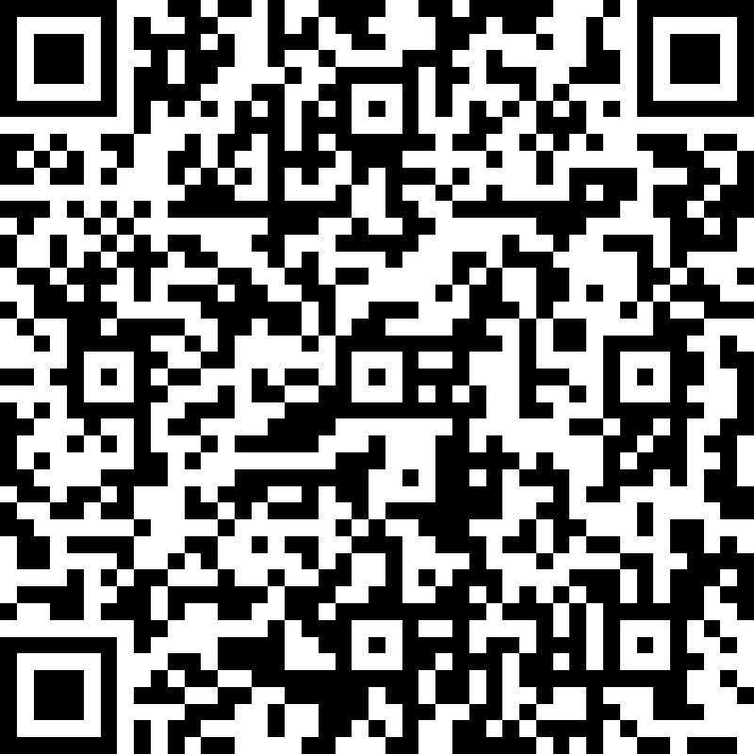
COMPETITION (WEEK 3)
REGISTERED PARTICIPANTS SCAN THE QR CODE TO ENTER THE PRIZE DRAW
COMPETITION AND PRIZE RULES
m365may.com/competition-rules

Slide 23


What is OAUTH?

Slide 24

What is OAUTH?
Authentication Framework (RFC 6749)
Allows Limited Access to a HTTP service.
Username / Password is exchanged by a tokens.
Tokens can have a limited lifetimes.
Access lists is defined using Scopes.
Notes:
OAUTH is an authentication framework that is used by APIs for authentication And security
OAUTH provides limited access to HTTP service based on the authorization that is presented to the user when set up.
OAUTH exchange’s user account credentials, with tokens that can be used for authentication instead. this is to protect the users credentials.
These tokens have limited lifetimes
To access API resources, the client must specify what resources they wish to access. These are called scopes.

Slide 25
SCOPES FAQ’S
Mechanism to limit application access to a user account.
Declared at App Registration and Client Authentication
Denoted by “action.location” (read.profile)
Scopes must be specified
Notes:
As I said earlier, scopes are used to limit application access to a user account. This ensure that any access outside those resources is meet with a 403.
Scopes are declared in the app registration process, (to define what resources the app is permitted to access) and also via the client.
The client is also required to declare which scopes they wish to access using a minimal approach. Accessing API’s without the correct scopes will fail.
Scopes are denoted by action dot location for instance (read.profile). The action describes the activity and the location the permission.
All scopes must be specified during authentication to receive an access token. Within that access token, the scopes are encoded into the Token. Variation of the scopes will cause the JWT token to fail.

Slide 26



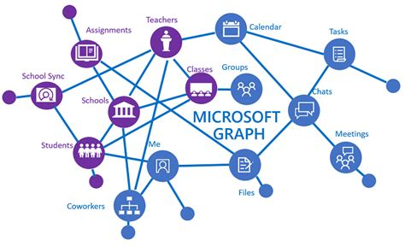
SCOPE EXAMPLE
AAD Application
Client
User.Read
User.Read
User.Read
Chat.Read
Mail.Read
User.Read
Microsoft Graph

Slide 27

SCOPE EXAMPLE
AAD Application
Client
User.Write
User.Read
Chat.Read
Mail.Read

Slide 28
SCOPE EXAMPLE
AAD Application
Client
User.Read
User.Read
User.Read
Chat.Read
Mail.Read
User.Write
Microsoft Graph

Slide 29
ACCESS TOKENS FAQ’S
Encoded Key used to access resources.
Signed using JWT.
Have a limited lifetime.
Treat as a Password.
Notes:
An Encoded Key that is used to access API resources.
Signed using JWT
They have a limited lifetime. (You can adjust the lifetime of the token)
They still are passwords and should be treated as such.

Slide 30
OAUTH 2.0 PROCESS
[Admin] Setup Access.
[Client] Setup Client
[Client] Request Authorization Code.
[Client] Request Access Token.
[Client] Use Service with Access Token.
Notes:
Setup Access – The administrator will connect to the Application Endpoint and Enable Access and define the scope of the permissions. The application will issue an Application Id / Client ID & Client Secret. We will also need to setup a callback url. These are approved URLs that the app can respond with the Authorization code.
Now we have setup access, the client is now configured to point to that Application ID
You now must get an Authorization Code. The authorization code is used by the application to verify that consent has been given by the user. This is when you see that nice popup box and the login form. The app with respond to the specified callback url.
In that url you will you have the Authorization Code. Using the Client ID, Secret, Scope, the callback URL and Code you can exchange it for an Access Token.
The access token is used for all API requests under the Authorization HTTP header.
When the access token is expired, a new token can be requested by exchanging the refresh token for a new access token.

Slide 31
Demo
Notes:
Step 1: Setup Access
Create an App Registration
New Registration
Note the Client ID
Redirect URL
Note the Scope
Step 2: Login and Authorization Code
Request Login
Response URL
Manually Browse to the URL response
Login
Approval the Scope
Step 3: Request Access Token
Request Access Token Using URL
Token Received

Slide 32
JWT (JSON WEB TOKEN) (RFC 7519)
Representative claims securely between two parties.
Plaintext / Encrypted Component
(PlainText != Encrypted) {return false}
Notes:
Json Web Token is a lightweight means of representing claims between two parties. In Oauth 2.0 it is used to validate the integrity of the Access Token. This is done when the server (“the issuer”) sends the token. Since it has issued the token using a private key, it can be validated
There is a plaintext and encrypted components. The plaintext is predominantly used and the encrypted component is used for verification.
When validating the authenticity of the payload, the server will check against the encrypted component using it’s private key. If they are different, then the token is different.

Slide 33
JWT Demo
Notes:
https://jwt.io/

Slide 34
Authenticating
with Microsoft Graph API
@PowerShellMich1

Slide 35
Setting up your Connection
Notes:
So the first thing we are going to do is setup our connection.
Browse to portal.azure.com (I have already Browse to it)
Open azure active directory
Inside of Azure Active Directory select: app registrations. let's go ahead and create a new app registration
To do that click new registration.
let's give it a name
Supported Account Types. Supported account types allow who can access use the application or API . in our instance it will be an API. there are three types:
single tenant: users within the tenant are allowed to access the application
multi tenant: any user account in any Azure ID tenant. it's worth mentioning that multi tenant is required for JavaScript Microsoft authentication library SDK.
multi tenant and personal Microsoft accounts.
Redirect URI: the redirect UIR is used to capture the authorization key. it's important to mention that only HTTPS sites are allowed (with the exception to localhost)
Click Register
The first thing to note here is the Application (client) ID. This is importance since this is used to identify which applaction this is. Let’s copy that into a notepad document.
We must also register a client secret. Let’s do that:
Click Certificates and Secrets:
New Client Secret.
Client Secret’s can have an expirey to ensure regular rotation of secrets. Let’s give it an expiry of 1 year.
In the description, give a brief description: M365May Secret
Click Add
Copy the Client Secret Value (You can only do this one)
Click on API Permissions. Here we allocate what Micorosoft Graph Permissions we wish to access.
Here you can see Add an API permission and Grant Admin Consent
The API permissions allow you to add specific api permissions
Admin Consent allows you to simplify the user process and authorization on behalf of the user account (so the user dosen’t have to do it). You would use this in the case of an internal applaction that is being hosted by your organization. Note that you need to have API permissions added to the configured permissions to use this.
Let’s add some API permissions
Click Add a permission
In this instance, select Microsoft Graph
In here you can select two permission types:
Delegated Permissions (The application needs to access the API) (We will revisit these)
Application Permissions (Background Services or daemons)
Open a permission
Note that these permissions REQUIRE admin consent, since they need to use some software.
Close
Add A Permission
MSGraph
Delegated.
We are going to add offline_access (This allows a refresh token)
Profile
Click Add Permissions
Our permission are now added
Click Branding
Branding is where you can apply a logo and Homepage, Terms of Service and Privacy Statement URLs.
Let’s add a logo:
D:\OneDrive\Talks\An Introduction into the Fundamentals of the Microsoft Graph API\Demos\Images
Add the Logo
Authentication:
Goto through the authentication:
Different Configuration have different authentication code callbacks.
If you click on Add a platform you can see all the different configurations. This is where you would add your production site and azure will configure the authentication configuration that is required.
Since we are using http://localhost and we are also using a Single Page Architecture we need to enable implicit grant. Implicit grant is used to obtain access tokens directly by the client (web page) and not the server.
Tick Access tokens and id tokens.
We also will need to enable “Treat this application as a public client”. This is needed by MSAL to authenticate.

Slide 36
Getting the Access Token
Sources: https://docs.microsoft.com/en-us/graph/auth-v2-user
Notes:
The first thing we need to do is obtain our access token. To do this we must do is request an authorization code.
Remember we need to use the authorization code so we can request an access token.
Let’s use Postman to structure our request:
Browse to Microsoft Graph Authentication:
Note to the user we need to insert the client_id, add the client_id
The scopes are separated by spaces
The response_type is required for tokens that require authorization flow. So admin consent doesn't require this (But ours do)
We must include the redirect URI. This needs to be a valid redirect URI that was captured in the application.
Let’s copy the URL and paste it into firefox
Login and pause on the authorization
Click approve
Now we have our Authorization Code, we can now obtain an Access Token.
Let’s open up Postman Again:
Select Obtain Token:
Explain to the audience that this is a HTTP request that we are doing.
Note that we are calling the Login.microsoft.online/token endpoint
Note that the method is a POST method
Note that the body encoding type is x-www-form-urlencoded. Explain that this is a encoding scheme where you can parse URL query parameters in the Body of the HTML request.
Create new tab
Paste: https://login.microsoftonline.com/9e74ca82-b838-41d9-9424-d7cf8a03e546/oauth2/v2.0/token?client_id=CLIENT_ID&scope=SCOPES&......
Explain that there are the same.
Note that we have selected body and we are encoding
Note that we require:
Client ID
Scope
Auth Code
Redirect URI
Client Secret
Paste items in and click SEND:

Slide 37
Calling Microsoft
Graph
Notes:
So let’s now call some Microsoft Graph Endpoints using Postman!
Let’s get the information about the user!
Demo Breakdown:
Obtaining the Access Token
Now I am going to copy that token and paste it into our notepad document
Demo 1 (Accessing Information that we have access to) As defined in our scopes
Note that we will be accessing the Microsoft Graph URL Endpoints
Note the HTTP method, we will be using is a HTTP get
For us to access this information we need to include an Authorization Header in our HTTP request.
The authorization header provides the webserver information about the identity that is trying to connect.
We are going to pass our bearer token in here. Remember that our bearer token contains information about our user
In the value of authentication we must prefix it with the type. This varies from API to API in this instance for an OAUTH token we must specify:
Bearer “token”
In other API’s this can be different.
Let’s send our request.
Note that we have a response! Huzzah!
Demo 2 (Access Information that we have access to, but nothing exists)
Note the URL endpoint here.
Note the response code
The HTTP error code.
Remember 404 means that it couldn't find any resources.
Demo 3 (Here we are trying to access all the user data in the tenant)
Since our applications, nor our scopes don’t have permission to this we expect to get a 403 (Forbidden)
Note the error
And the Status Code

Slide 38
Using MSAL
Notes:
While that was interesting, let’s use MSAL to authenticate with Microsoft Graph.
Microsoft Authentication Library makes is super easy for use for you to authenticate and obtain a token. Let’s take a look!

Slide 39
Navigating
Microsoft Graph URL Endpoints
@PowerShellMich1

Slide 40
Using
Microsoft Graph Explorer
Notes:
Things to know:
3 API Endpoints (v1.0, Beta & Other)
Keep in mine that Beta and Other are not supported.
Microsoft Graph Tokens don’t work outside of Graph API. (One Note API for instance)
https://developer.microsoft.com/en-us/graph/graph-explorer
https://docs.microsoft.com/en-us/graph/api/user-post-messages?view=graph-rest-1.0&tabs=http

Slide 41
Handy Dandy Links
https://developer.microsoft.com/
https://www.postman.com/
https://docs.microsoft.com/en-us/graph/api/overview?toc=.%2Fref%2Ftoc.json&view=graph-rest-1.0
https://github.com/AzureAD/microsoft-authentication-library-for-dotnet
https://github.com/AzureAD/microsoft-authentication-library-for-js

Slide 42














THANK YOU TO OUR SPONSORS
THANK YOU TO OUR SPONSORS

Slide 43
Thankyou!
@PowerShellMich1
https://github.com/ZanattaMichael/BrisPug
https://twitch.tv/PowerShellMichael

Slide 44
Questions?

